Slide 1
Warm-Up
Has violence become too accepted within our culture? Why or why not?
Are human beings innately violent? Why or why not?
Use specific examples. Explain your answer.

Slide 2
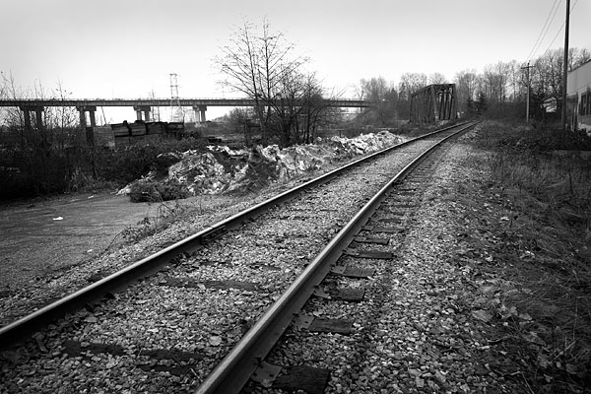
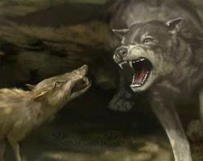
Vocabulary List #4
Lacerate (Verb): To tear or deeply cut.
Bleak (Adj.): Charmless and inhospitable; dreary.
Menacing (Adj.): Suggesting the presence of danger.
Brute (Noun): A savagely violent person or animal.
Debacle (Noun): A sudden disastrous collapse.

Slide 3
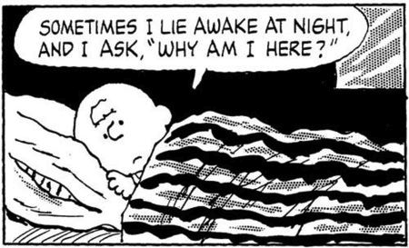
Vocabulary List #4
Imprudent (Adj.): Not showing care for the consequences of an action; rash.
Ennui (Noun): A feeling of listlessness and dissatisfaction arising from a lack of occupation or excitement.
Sallow (Adj.): Of an unhealthy yellow or pale brown color.
Venerable (Adj.): Accorded a great deal of respect.
Quarry (Noun): One that is sought or pursued.

Slide 4
Pronouns
Replaces a noun or a pronoun.
Personal Pronoun: A specific person or thing that changes its form to indicate person, number, gender, and case.
Subjective v. Objective Pronoun: Pronoun is acting as the subject or the object of the sentence.
Possessive Pronoun: Marker of possession and defines who owns the object or person.
Demonstrative: Identifies a noun or pronoun. This/These. That/Those.
Interrogative: Asks questions.

Slide 5
Pronouns Write down the antecedent for the pronoun.
I’ve always wanted to go there.
He is the coolest man alive!
I had to save money for years to buy THAT.
It’s dangerous to go alone; here, take THIS.
It would be fun to spend a weekend with THEM.
THOSE have always frightened me.
I couldn’t decide, so I ate BOTH.
I wish THEY would keep their opinions to themselves.

