Slide 1
Vocab Week 3
Ms. Burton

Slide 2
Warm-Up

Slide 3
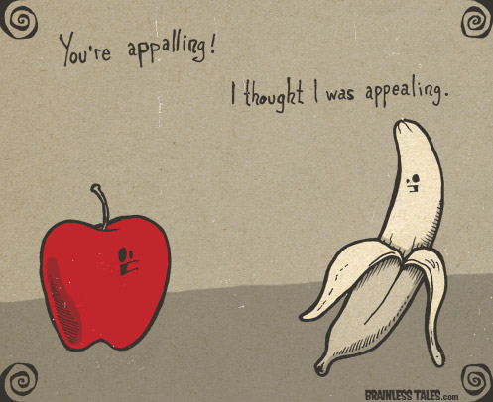
Vocabulary List 3
Collegiate (Adjective) – Relating to a college or its students.
Prosecute (Verb) – Institute legal proceedings against.
Gritty (Adjective)- Hardy or resolute.
Appall (Verb)- Greatly dismay or horrify.
Forge (Verb)- To advance steadily.

Slide 4
Vocabulary List 3
Mourning (Noun)- The expression of deep sorrow for someone who has died.
Impromptu (Adjective)- Done without being planned.
Discharge (Verb)- Tell someone officially that they can or must leave.
Accessory (Noun)- Someone who gives assistance to the perpetrator of a crime.
Convict (Noun)- A person found guilty of a criminal offense.

Slide 5
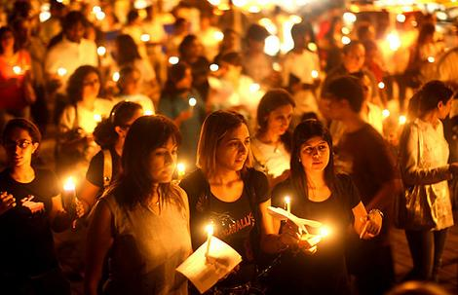
Vocabulary List 3

Slide 6
Adverbs
An adverb modifies a verb, an adjective, another adverb, a phrase, or a clause.
An adverb indicates manner, time, place, cause, or degree.
Manner: She quickly made the dress.
Time: She made the dress yesterday.
Place: The dress is here.
Cause: I wear sunglasses to look cool.
Degree: That is the farthest I have ever jumped.

Slide 7
Adverbs
Adverbs answer the questions “How” “where” “when” and “how much”
How did you speak?
Where did you shop?
When did you do eat?
How much did you spend?

Slide 8
Adverbs
For each verb or adjective, use an adverb to modify it:
Accelerate
Expand
Soar
Urge
Tackle
Beautiful
Weep
Rap
Dance
Levitate
Float
Gritty
Appalling

Slide 9
Adverbs
Choose five of the words, and write a sentence using your adverb.
For example:
I aggressively tackled the other football players.
Beyonce is incredibly beautiful.
Miley Cyrus danced disgustingly at the MTV VMAs.

Slide 10
Adverbs
Homework:
Adverb worksheet due Wednesday.
Quiz on Vocabulary and Adverbs on Friday.

Slide 11
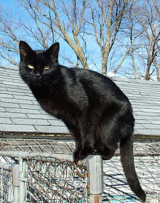
Symbol Share
State what your symbol is, and how it symbolizes you, your culture, or our society.

