Slide 1
Symbolism in The Scarlet Ibis
Ms. Burton

Slide 2
What is a Symbol?
Symbol: A word or object that stands for another word or object. The object or word can be seen with the eye or not visible.
For example, what is the symbol for peace?
What are some other common symbols in our society?

Slide 3
Symbols in “The Scarlet Ibis”
Brainstorm and compile a list of the symbols you believe are in “The Scarlet Ibis.”
Then, write what you think they might mean/how they are related to the theme/characters within the story.

Slide 4
Close Reading
At that moment the bird began to flutter, but the wings were uncoordinated, and amid much flapping and a spray of flying feathers, it tumbled down, bumping through the limbs of the bleeding tree and landing at our feet with a thud. Its long, graceful neck jerked twice into an S, then straightened out, and the bird was still. A white veil came over the eyes and the long white beak unhinged. Its legs were crossed and its clawlike feet were delicately curved at rest. Even death did not mar its grace, for it lay on the earth like a broken vase of red flowers, and we stood around it, awed by its exotic beauty.

Slide 5
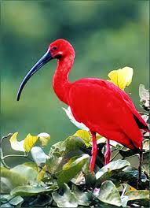
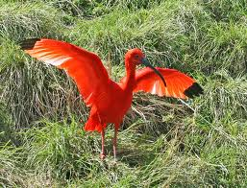
Doodle/Scarlet Ibis
How are Doodle and the scarlet ibis similar? Identify the characteristics.

Slide 6
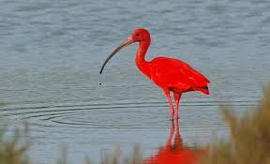
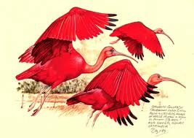
The Scarlet Ibis
"Dead birds is bad luck," said Aunt Nicey, poking her head from the kitchen door. "Specially red dead birds!”
What is this bird a symbol of?

Slide 7
Symbols in your life
What could be a symbol for you?
What could be a symbol for your culture?
What could be a symbol for our culture?

Slide 8
Homework
Create a visual that is a symbol of you, your family/culture, or our culture.
Be creative!
Make it stand out.
Write a paragraph explaining your symbol, and evaluating how it depicts you, your family, or our culture.

