Slide 1
MLA Format
Ms. Burton
English 9A

Slide 2
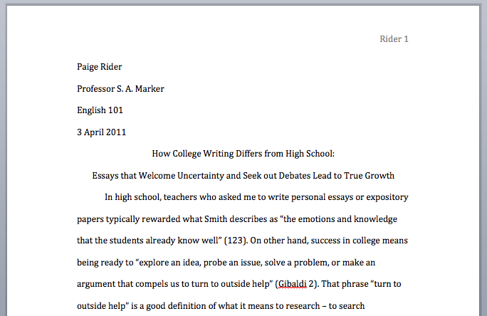
MLA FORMAT
Double Spaced
12 pt font
Times New Roman

Slide 3
MLA FORMAT
One inch margins on all sides
Header: Your last name and the running page number

Slide 4
MLA FORMAT
First 4 lines on left side:
Your Name
My Name
Name of class
Date (Day Month Year)

Slide 5
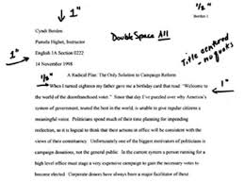
MLA Format
Title: Centered, not bold, italicized or underlined. In the same font as rest of essay.
All paragraphs are indented a half inch.

Slide 6
MLA Format
Go to www.hartdistrict.org/valencia
Go the English Department page, and you will see a Department Writing Guide.
More MLA Formatting help is on the link that says MLA Style.

